Slide 1
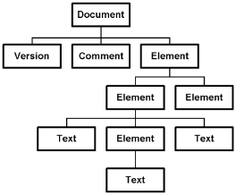






Processing JSON in .NET
JSON, JSON.NET LINQ-to-JSON and JSON to XML
Database
Applications
SoftUni Team
Technical Trainers
Software University
http://softuni.bg

Slide 2


Table of Contents
The JSON data format
Rules and Features
Usage
JSON.NET Overview
Installation and Usage
LINQ-to-JSON
JSON to XML and XML to JSON

Slide 3

The JSON Data Format
What is JSON?

Slide 4
The JSON Data Format
JSON (JavaScript Object Notation) is a lightweight data format
Human and machine-readable
Based on the way to create objects in JavaScript
Independent of development platforms and languages
JSON data consists of:
Values (strings, numbers, etc.)
Key-value pairs: { key : value }
Arrays: [value1, value2, …}

Slide 5
JSON Data Format
The JSON data format follows the rules of object creation in JS
Strings, numbers and Booleans are valid JSON:
Arrays are valid JSON:
Objects are valid JSON (key-value pairs):
"this is string and is valid JSON"
3.14
true
[5, 'string', true]
{
"firstName": "Vladimir", "lastName": "Georgiev",
"jobTitle": "Technical Trainer", age: 25
}

Slide 6

Processing JSON in .NET
How to Parse JSON in C# and .NET Framework?

Slide 7
Built-in JSON Serializers
.NET has built-in JSON serializer:
The JavaScriptSerializer class
Contained in System.Web.Extensions assembly
JavaScriptSerializer can parse from object to JSON string and vice versa:
var place = new Place(…);
var serializer = new JavaScriptSerializer();
var jsonPlace = serializer.Serialize(place);
var objPlace = serializer.Deserialize<Place>(jsonPlace);

Slide 8



JavaScript Serializer
Live Demo

Slide 9
JavaScriptSerializer Features
The .NET JavaScript serializer is powerful:
Serialize objects to JSON and vice versa
Serialize / deserialize dictionaries correctly:
var digits = new Dictionary<string, int>
{
{ "one", 1 },
{ "two", 2 },
};
var serializer = new JavaScriptSerializer();
string json = serializer.Serialize(digits);
var d = serializer.Deserialize<Dictionary<string,int>>(json);

Slide 10
JavaScriptSerializer Features
JavaScript serializer has nice features:
Serializing objects to JSON and vice versa
Correct parsing of dictionaries:
Is parsed to
var digits = new Dictionary<string, int>
{
{ "one", 1},
{ "two", 2},
…
};
{
"one": 1, "two": 2,
…
}

Slide 11
JavaScript Serializer Features
Live Demo

Slide 12

JSON.NET
Better JSON Parsing for .NET Developers

Slide 13
JSON.NET
JavaScriptSerializer is good
But JSON.NET is better
JSON.NET:
Has better performance
Supports LINQ-to-JSON
Out-of-the-box support for parsing between JSON and XML
Open-source project: http://www.newtonsoft.com

Slide 14
Installing JSON.NET
To install JSON.NET run in the NuGet Package Manager Console:
Has two primary methods:
Serialize an object:
Deserialize an object:
$ Install-Package Newtonsoft.Json
var serializedPlace = JsonConvert.SerializeObject(place);
var deserializedPlace =
JsonConvert.DeserializeObject<Place>(serializedPlace);

Slide 15
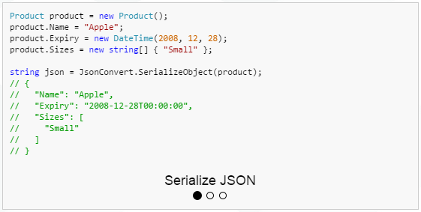
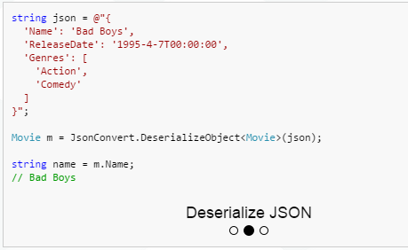
Serializing and Deserializing Objects
Live Demo

Slide 16

JSON.NET Features

Slide 17
JSON.NET Features
JSON.NET can be configured to:
Indent the output JSON string
To convert JSON to anonymous types
To control the casing and properties to parse
To skip errors
JSON.NET also supports:
LINQ-to-JSON
Direct parse between XML and JSON

Slide 18

Configuring JSON.NET
JSON.NET

Slide 19
Configuring JSON.NET
To indent the output string use Formatting.Indented:
Deserializing to anonymous types:
JsonConvert.SerializeObject(place, Formatting.Indented);
var json = @"{ 'firstName': 'Vladimir',
'lastName': 'Georgiev', 'jobTitle': 'Technical Trainer' }";
var template = new
{
FirstName = string.Empty,
LastName = string.Empty,
Occupation = string.Empty
};
var person = JsonConvert.DeserializeAnonymousType(json, template);
Should provide a template
Should provide a template

Slide 20
Configuring JSON.NET
JSON.NET
Live Demo

Slide 21
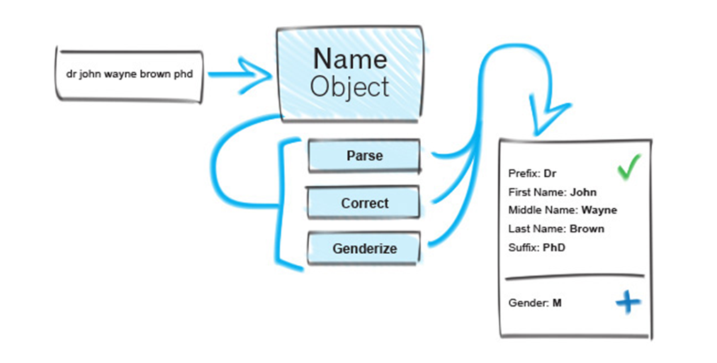
JSON.NET Object Parsing

Slide 22
JSON.NET Parsing of Objects
By default JSON.NET takes each property / field from the public interface of a class and parses it
This can be controlled using attributes:
public class User
{
[JsonProperty("user")]
public string Username { get; set; }
[JsonIgnore]
public string Password { get; set; }
}
Parse Username to user
Skip the property

Slide 23
JSON.NET Object Parsing
Live Demo

Slide 24

LINQ-to-JSON
Using LINQ to JSON with JSON.NET

Slide 25
LINQ-to-JSON
JSON.NET supports LINQ-to-JSON:
var jsonObj = JObject.Parse(json);
Console.WriteLine("Places in {0}:", jsonObj["name"]);
jsonObj["places"]
.Select(pl => string.Format("{0}) {1} ({2})",
index++,
pl["name"],
string.Join(", ", pl["categories"]
.Select(cat => cat["name"]))))
.Print();

Slide 26
LINQ-to-JSON
Live Demo

Slide 27
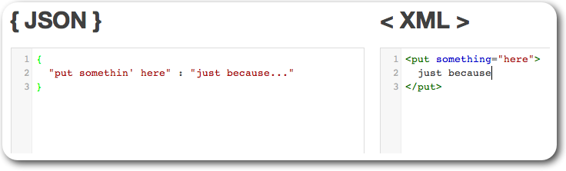
XML to JSON and JSON to XML

Slide 28
XML to JSON and JSON to XML
Conversions from JSON to XML are done using two methods:
XML to JSON
JSON to XML
string jsonFromXml =
JsonConvert.SerializeXNode(doc);
XDocument xmlFromJson =
JsonConvert.DeserializeXNode(json);

Slide 29
XML to JSON and JSON to XML
Live Demo

Slide 30









Database Applications – Course Introduction
https://softuni.bg/courses/database-applications/

Slide 31
License
This course (slides, examples, demos, videos, homework, etc.) is licensed under the "Creative Commons Attribution-NonCommercial-ShareAlike 4.0 International" license
Attribution: this work may contain portions from
"Databases" course by Telerik Academy under CC-BY-NC-SA license

Slide 32





Free Trainings @ Software University
Software University Foundation – softuni.org
Software University – High-Quality Education, Profession and Job for Software Developers
softuni.bg
Software University @ Facebook
facebook.com/SoftwareUniversity
Software University @ YouTube
youtube.com/SoftwareUniversity
Software University Forums – forum.softuni.bg

